Slide 1
Routing Techniques
Simple routing
Navigating
Dynamic routes
Route groups
Parallel routes

Slide 2
Section 1: Simple Routing
Overview
Defining the root layout
Defining routes
Defining a nested layout
Special files

Slide 3
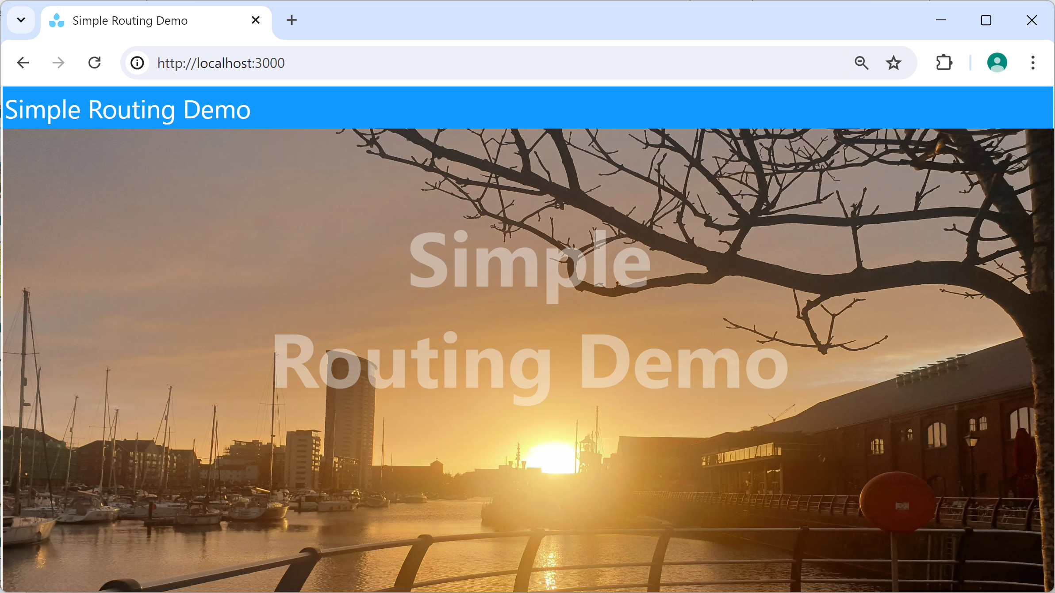
Overview
In this section we'll start taking a closer look at how routing works in Next.js
See the demo app demo-simple-routing
Prepare and run as follows:
npm install
npm run dev

Slide 4
Defining the Root Layout (1 of 2)
Your application must define a root layout
Defines a shared layout for all pages in the application
export default function RootLayout({children}: … ) {
return (
<html lang="en">
<body>
<div className="banner">Simple Routing Demo</div>
{children}
</body>
</html>
);
}
/app/layout.tsx

Slide 5
Defining the Root Layout (2 of 2)
The root layout can also specify metadata for the browser to utilize
import type { Metadata } from "next";
…
export const metadata: Metadata = {
title: "Simple Routing Demo",
description: "Example of simple routing in Next.js",
};
…
/app/layout.tsx
For more information about defining browser metadata, see: https://nextjs.org/docs/app/api-reference/functions/generate-metadata

Slide 6
Defining Routes
Our demo app defines several routes
The layout applies to all of them
Try out the following routes in a browser, then take a look at the corresponding page file in the code…
Route | Page file in the code
/ | /app/page.tsx
/about | /app/about/page.tsx
/contact | /app/contact/page.tsx

Slide 7
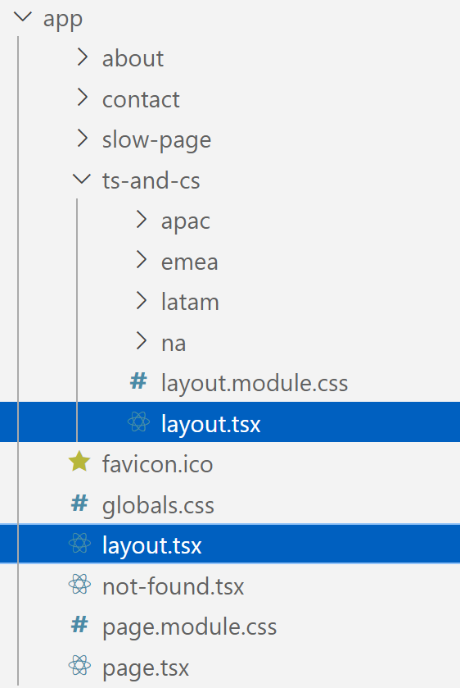
Defining a Nested Layout
You can define nested layouts in an app
They apply for all descendant routes in the folder hierarchy
E.g., navigate to /ts-and-cs/apac to see the effect
Nested layout
Applies to /ts-and-cs route (and descendants)
Root layout
Applies to all pages in the app

Slide 8
Special Files
There are several special files you can define, including…
/app/not-found.js
Handles any unmatched URLs for the whole application
In the demo app, try navigating to an unmatched URL
/app/some-route/loading.js
Displays a "pending" URL while a slow page is loading
In the demo app, try navigating to /my-slow-page
For a full list of all special files available in Next.js, see: https://nextjs.org/docs/app/building-your-application/routing#file-conventions

Slide 9
Section 2: Navigating
Overview
How to define links to routes
Example links in the demo app
Performing programmatic navigation

Slide 10
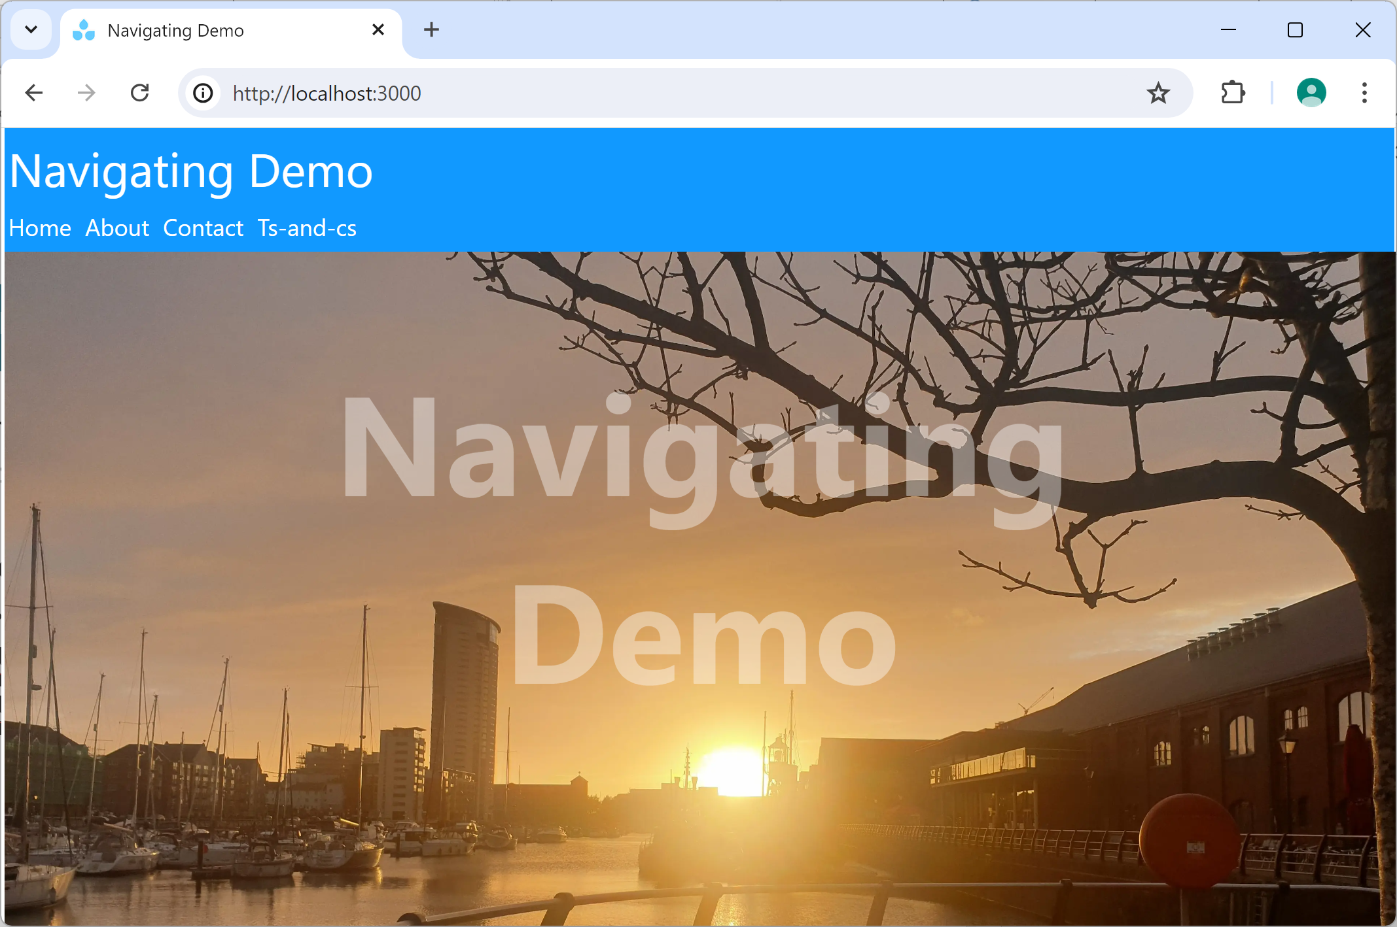
Overview
In this section we'll see how to define links, to enable a user to navigate routes easily
See the demo app demo-navigating
Prepare and run as follows:
npm install
npm run dev

Slide 11
How to Define Links to Routes
To define links to routes:
Use the Link component, defined in 'next/link'
Set the href property (required) to an absolute route
Optional properties:
replace - replace current history state (default is false)
scroll - scroll to top of new route (default is true)
prefetch - prefetch route (default is true for static routes)
import Link from 'next/link'
…
<Link href="/some-absolute-route">Some label for the link</Link>
some_component.tsx

Slide 12
Example Links in the Demo App
The root layout displays a menu of links to all routes
See /app/layout.tsx
Also see /app/_components/menu.tsx
The ts-and-cs page displays links for all ts-and-cs routes
See /app/ts-and-cs/page.tsx
Note: A folder that starts with _ is a private folder
Indicates the folder is a private implementation detail
Not part of the routing system

Slide 13
Performing Programmatic Navigation
Link specifies a hard-coded route, as we've just seen
It's also possible to perform programmatic navigation to a computed route…
For a server component, use redirect()
For a client component, use useRouter()
See later for details…

Slide 14
Section 3: Dynamic Routes
Overview
What is a dynamic route?
Defining a dynamic route
Accessing dynamic segment values
Accessing search parameters
Demo application

Slide 15
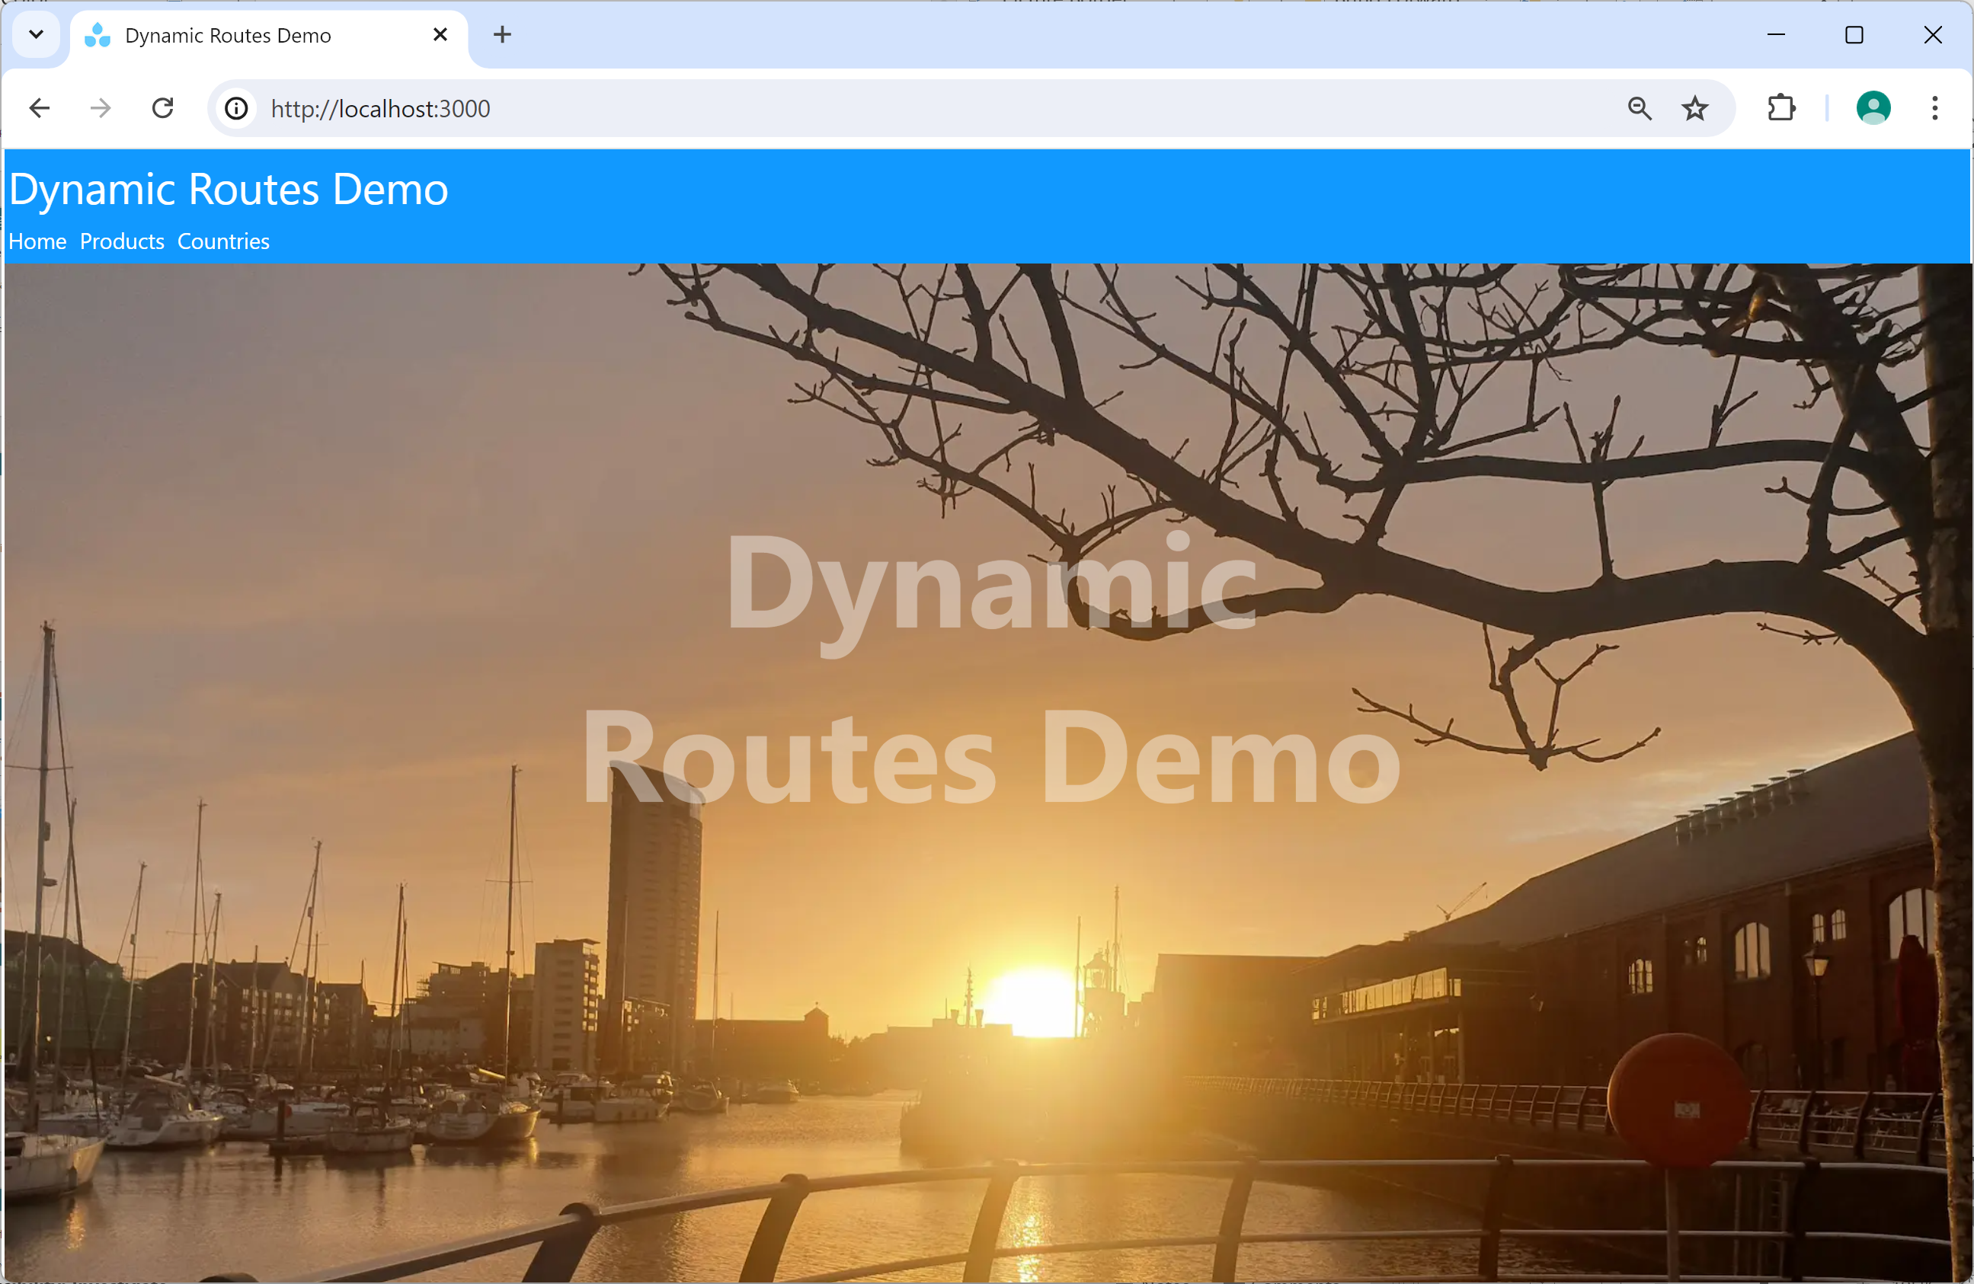
Overview
In this section we'll see how to define dynamic routes, which contain parameterized route segment(s)
See the demo app demo-dynamic-routes
Prepare and run as follows:
npm install
npm run dev

Slide 16
What is a Dynamic Route?
A dynamic route contains one or more dynamic segments
i.e., a parameterized part of the URL
Here's a dynamic route with a single dynamic segment:
/product/1
/product/2
Here's a dynamic route with two dynamic segments:
/Norway/Oslo
/UK/Swansea

Slide 17
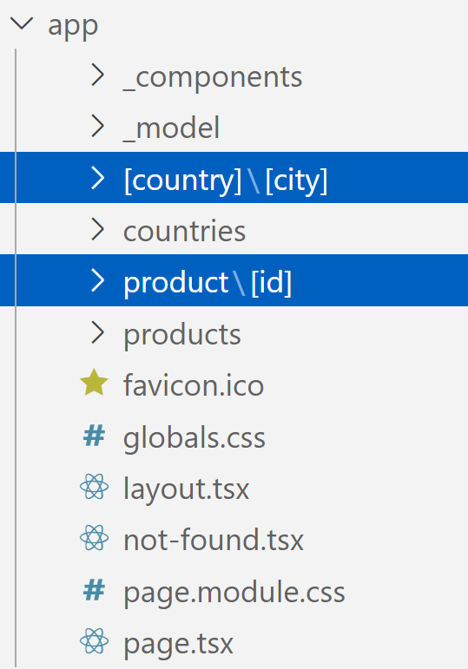
Defining a Dynamic Route
To define a dynamic route:
Define folders for each route segment, as usual
For a dynamic route segment, enclose the folder name in []
country and city are dynamic segments
For example, /Norway/Oslo
id is a dynamic segment
For example, /product/1

Slide 18
Accessing Dynamic Segment Values
When the user navigates to a dynamic route:
The page receives a params property
params holds all the dynamic segment value(s)
export default function Product(
{params}: {params: {id: string}}
) {
const id = params.id
…
/app/product/[id]/page.tsx
export default function City(
{params}: {params: {country: string, city: string}}
) {
const country = params.country
const city = params.city
…
/app/[country]/[city]/page.tsx

Slide 19
Accessing Search Parameters
A URL can contain search parameters
E.g., /product/1?verbose=true
The page receives a searchParams property
searchParams holds all the search parameters
export default function Product(
{params, searchParams}: {params: {id: string},
searchParams: {verbose: boolean}}
) {
const verbose = searchParams.verbose
…
/app/product/[id]/page.tsx

Slide 20
Demo Application
Here are the product-related files in the demo app:
/app/_model/catalog.ts
/app/products/page.tsx
/app/product/[id]/page.tsx
Here are the country/city-related files in the demo app:
/app/_model/countries-and-cities.ts
/app/countries/page.tsx
/app/[country]/[city]/page.tsx

Slide 21
Section 4: Route Groups
Overview
Dealing with lots of routes: the problem
Dealing with lots of routes: the solution
Defining route groups

Slide 22
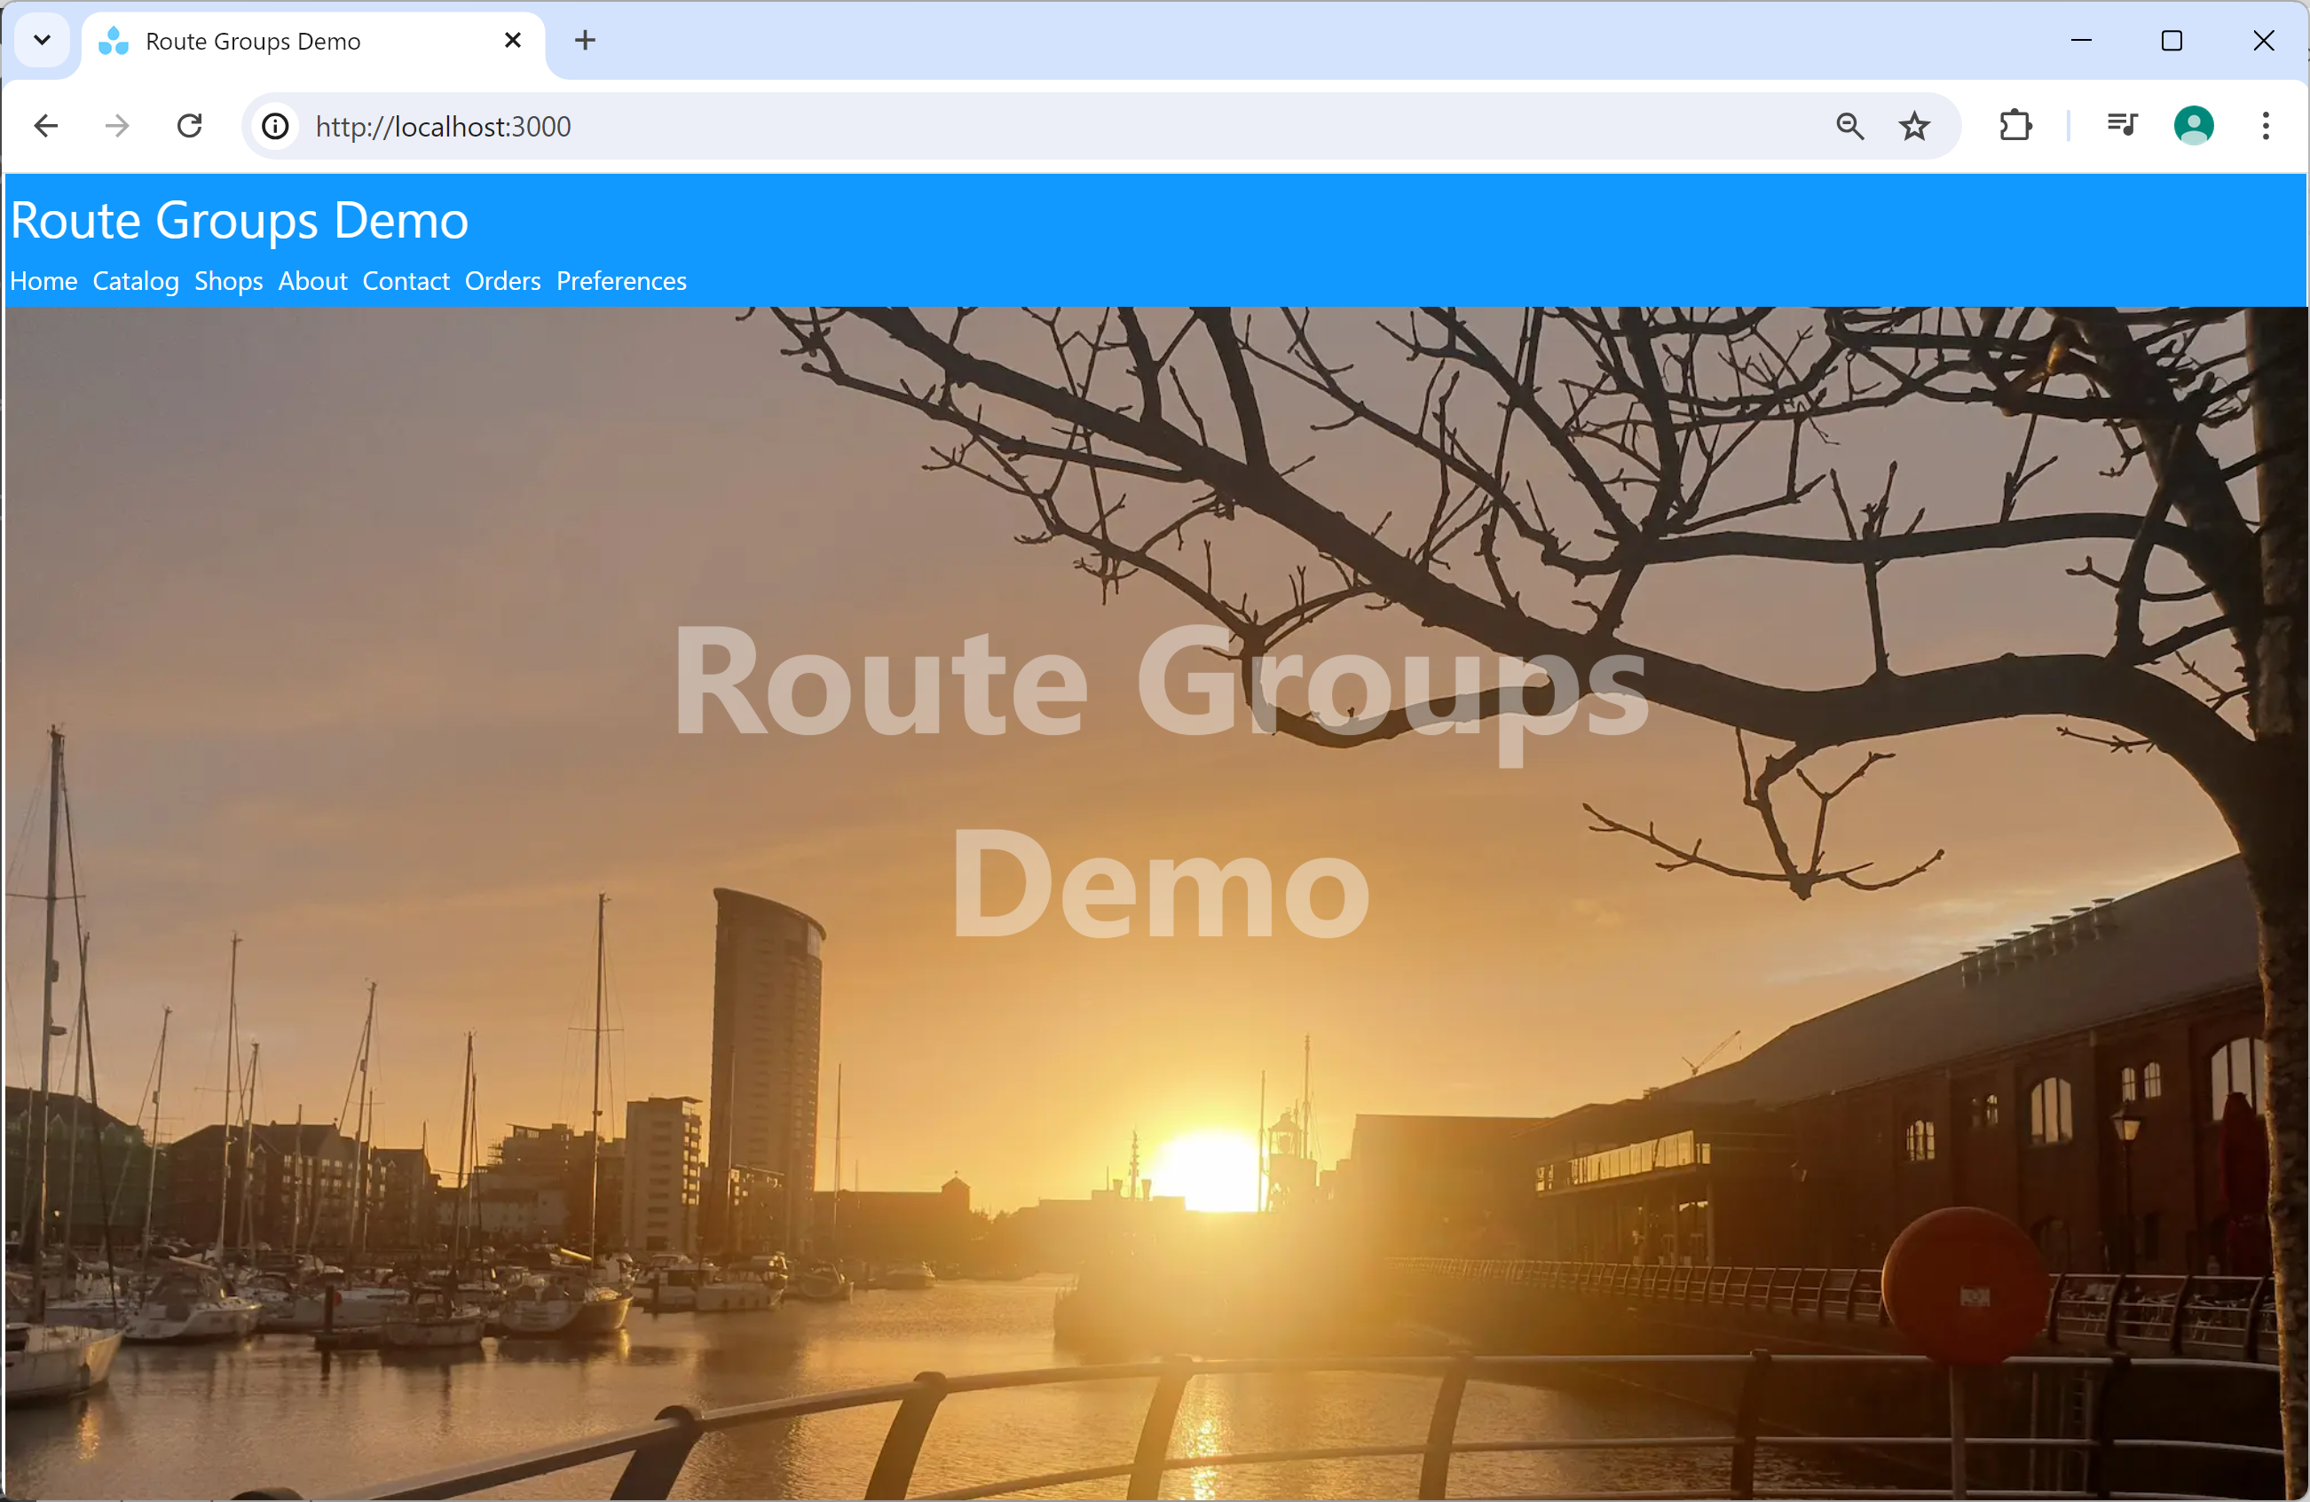
Overview
In this section we'll see how to define route groups, which enable you to group related routes together
See the demo app demo-route-groups
Prepare and run as follows:
npm install
npm run dev

Slide 23
Dealing with Lots of Routes: The Problem
A realistic application might contain 100s of routes
Each route is a separate folder
This means a lot of folders in your application!
For example, try out the demo app
How many different routes does it have?
Do you notice anything in common between some routes?

Slide 24
Dealing with Lots of Routes: The Solution
You can collate related routes into a route group
A route group is a folder name enclosed in ()
The route group folder name is not part of the route
Why define route groups?
Helps you organize your application's folder structure
You can define a common layout for routes in a group
You can even define a completely different root layout for each route group, each with its own distinct UI

Slide 25
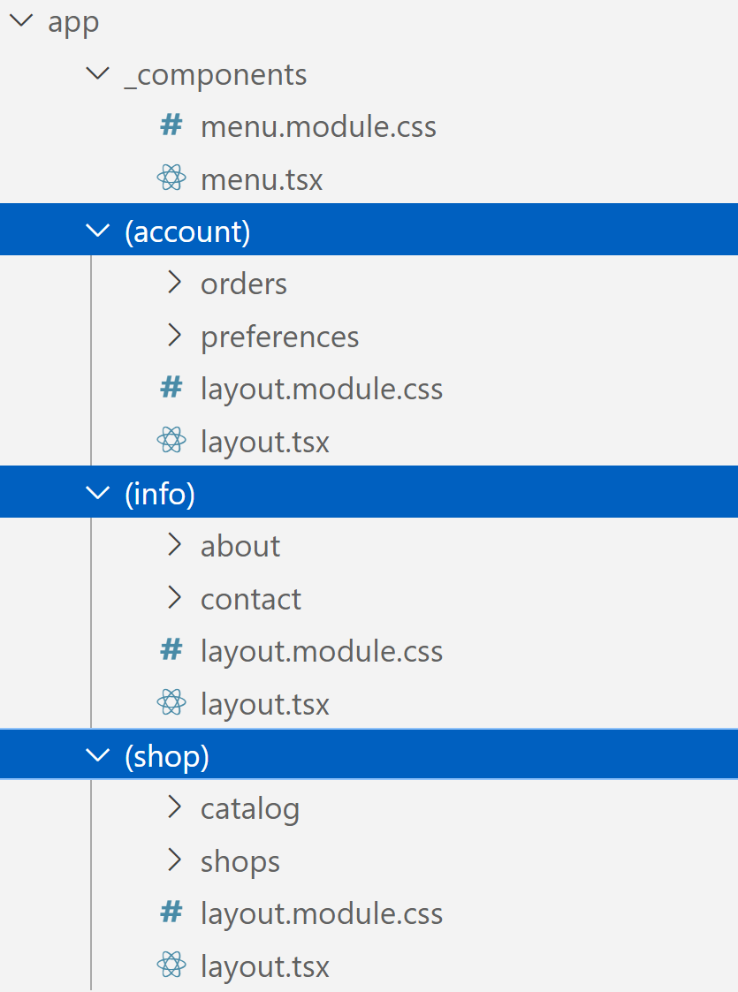
Defining Route Groups
Here's the folder structure in our demo app:
(account) route group, collates these routes:
/orders
/preferences
(info) route group, collates these routes:
/about
/contact
(shop) route group, collates these routes:
/catalog
/shops

Slide 26
Section 5: Parallel Routes
Overview
What are parallel routes?
Defining parallel routes
Conditionally rendering one parallel route
Simultaneously rendering multiple parallel routes

Slide 27

Overview
In this section we'll see how to define parallel routes, where you can render multiple pages in the same layout
See the demo app demo-parallel-routes
Prepare and run as follows:
npm install
npm run dev

Slide 28
What are Parallel Routes?
Parallel routes are where you can render multiple pages within the same layout
You can choose how parallel routes are rendered:
Either render one parallel route conditionally
Or render multiple parallel routes simultaneously

Slide 29
Defining Parallel Routes (1 of 2)
Define a parent folder, to house a bunch of parallel routes
In this folder, define a layout
The layout will receive all the parallel routes as properties
Define subfolders for the parallel routes, starting with @
(In the Next.js docs, these folders are called named slots)
For each named slot, define a suitable page
Note: The user navigates to the parent folder
The named slots are not route segments in their own right

Slide 30
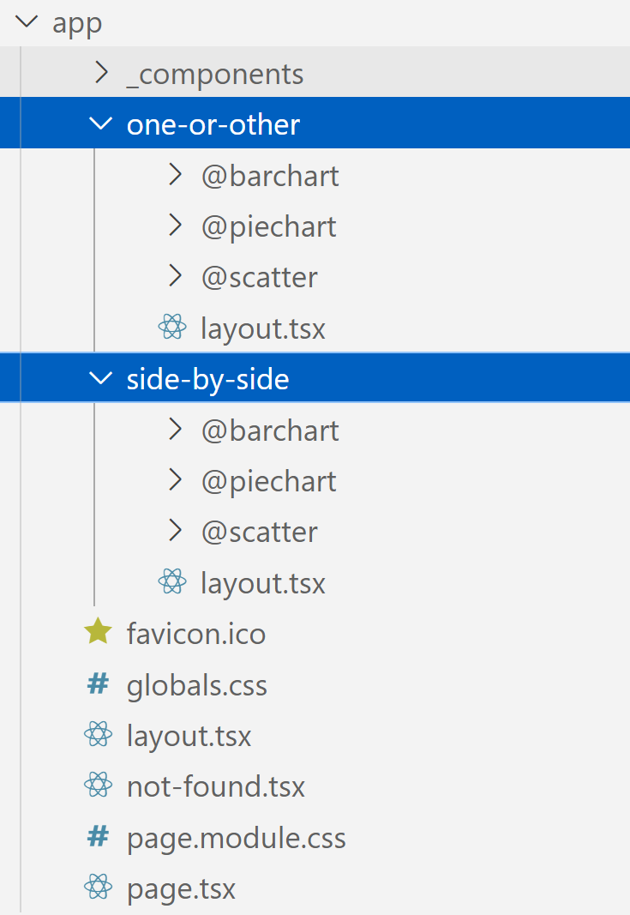
Defining Parallel Routes (2 of 2)
Here's the folder structure in our demo app:
one-or-other route, conditionally renders one of the parallel routes
side-by-side route, simultaneously renders multiple parallel routes

Slide 31
Conditionally Rendering One Parallel Route
export default function Layout({
barchart,
piechart,
scatter
}: Readonly<{
barchart: React.ReactNode,
piechart: React.ReactNode,
scatter: React.ReactNode
}>) {
const num = luckyDip(3)
let content: React.ReactNode
if (num === 0) { content = barchart; }
else if (num === 1) { content = piechart; }
else { content = scatter; }
return <> … {content} … </>
}
/app/one-or-other/layout.tsx

Slide 32
Simultaneously Rendering Multiple Parallel Routes
export default function Layout({
barchart,
piechart,
scatter
}: Readonly<{
barchart: React.ReactNode,
piechart: React.ReactNode,
scatter: React.ReactNode
}>) {
return (
<>
…
{barchart}
{piechart}
{scatter}
…
</>
);
}
/app/side-by-side/layout.tsx

Slide 33
Summary
Simple routing
Navigating
Dynamic routes
Route groups
Parallel routes

